Slide 1


Collaborative File Sharing Using File Manager Over Object Storage
Project Guide:Prof. R.V. Gupta
Seminar by: Sarvesh Kaushik
Hrishikesh Pusadkar
Keval jajoo
Rishikesh khadekar
Brijraj sadani

Slide 2
CONTENTS
Introduction
Objectives
Modules
Project flow Diagram
Application
Advantages and Disadvantages
Technologies Used
Conclusion

Slide 3
introduction
People tend to have their data on more than one device these days. Security of this data is important along with its correctness. Cloud storage services are hence blooming in the market providing users with varied data storage facilities where client can store his data on the web and access it as and when required.
Selecting the correct underlying storage system can greatly impact the success or failure of implementing cloud storage. Here, we use the new type of storage, called the Object Storage that has started to gain major traction in the market, especially since it has been validated by companies like Amazon, Google, and Facebook, which use this type of architecture to power their very large infrastructures, and their petabyte sized implementations.

Slide 4
Openstack Swift is one such large object store. Having storage based service design in mind, we introduce an intermediate server to perform the job of authentication of client and maintaining a consistency between the client data at his/her devices by carrying out the function of synchronization. Any changes made on any of the devices of a user, are automatically updated at all the other devices.

Slide 5
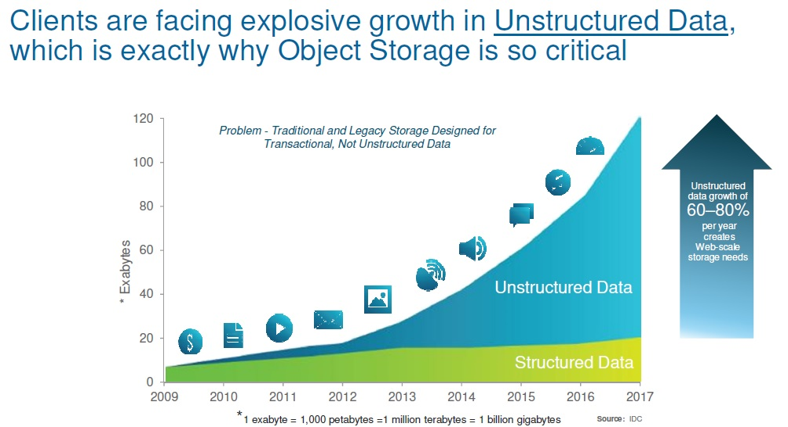

Slide 6
objectives
TO develop a cloud based file sharing system
To implement object storage system
To increase the security and availability of the uploaded documents
Notes:
File sharing is one of the oldest applications of the internet.
One way of sharing
files online is for a user to upload files to a common space on the web and others users
can download the files from the common web space.
The objective of this project was to design an online collaberative file sharing using File Manager over object storage where users can upload files and other users can download them.
To attain this objective AJAX enabled interactive user interface is used.The visual studio 2017 is the basic tool for visualization of website which provided the differnet functionalities like ADO.NET,ASP.NET by using which the website is created.Where as the security is established by genrating Generating SHA hash value of document
Storing hash value with meta data on application server.Another important factor affecting the security is use of modified AES encryption algorithm.
This report discusses the implementation details of the website, and the
advantages of having different visualizations of the object storage system. This report also addresses
one frequently asked question regarding storage;that how to Maintain and Analyze the enormous
amount of data with a certain ease? This report analyzes the time
needed to upload, download and search the data stored in objects which in turns lie on the flat address space and discusses the Merits and Demerits of both techniques in terms of performance, security,
integrity, maintenance and code complexity.

Slide 7
Working
Backup cloud
Storage cloud
Objects
Objects
Application cloud
Encrypt document using Modified AES algorithm
Generate Meta data
DB
Get Document Metadata and object location
Upload Documents
View Documents
Login
Decrypt Document
Specify Secrete key
Registration

Slide 8
MODULES
Admin panel
User management
Document Sharing
Encryption
Decryption

Slide 9
Admin panel
Login
View object storage capacity and occupied space
View user details

Slide 10
User management
Registration
Login
Change password
Upload document
View own documents
Share documents
Download documents
Access permission management

Slide 11
Document Sharing
Manage document access permission
Remove access permission
Download shared documents

Slide 12
Upload Document
Upload document
Generate SHA hash value of document
Store hash value with meta data on application server
Encrypt document using modified AES algorithm
Store Encrypted document on storage server as well as backup server

Slide 13
Encryption Algorithm
Upload document
Read document into bytes[]
Reverse byte[]
Generate secrete key randomly
Apply AES to encrypt the document
Store Encrypted document on storage server as well as backup server

Slide 14
Download Document
View documents details
Get key on email if having access permission
Specify key
Key verification
If user is a authenticated user, document will be fetched from storage server using meta data stored on application server
Decrypt document using key
Generate hash value
Compare hash value with stored one
If both hash values are same, deliver the document to user
Other wise fetch the document from backup file

Slide 15
Decryption
Read file bytes[]
Decrypt document using AES
Reverse bytes[]
Convert bytes[] into file
Store file on server tempararily

Slide 16
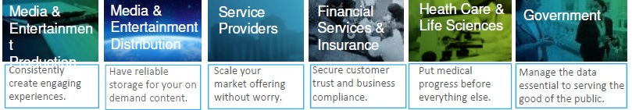
Applications
Corporate document repository
Document sharing system
Personal Health records storage

Slide 17
advantages
Provides a secure a way for file sharing
Using this method cloud Efficiency is increased
Backup is available in any unexpected case
Files can be accessed by any device by the user

Slide 18
Disadvantage
Person not getting access to data can intentionally deface the data which is overcome using backup server.
Historically, the disadvantage of object storage has been performance, as data retrieval is generally considered slower than with a file system.
Application cloud is needed for storing metadata.

Slide 19
Conclusion
This project will provide a secure platform for storing files to the online cloud and will reduce the overloading of the cloud resources and increased efficiency of cloud.

Slide 20
Technologies used:
Deployment Platform: Windows
Web Server: IIS
Development Technology : ASP.NET(SERVERSIDE),C#(LANGUAGE),CSS
Database technologies: MS SQL Server 2016
Development Tool: Visual Studio 2017

Slide 21
Thank you

